Slide 1
CSCE 823 In Class Day 11
ANN Training: RNN
Live Synchronous session

Slide 2
Agenda
Why RNNs?
RNN Key Characteristics, Parameters and Decisions
Break
Visualization Code – RNN text generation [Demo only]
General Q&A

Slide 3
CSCE 823 so far…
Perceptrons handle linear decisions
Unable to deal with nonlinearities
ANNs can handle nonlinearities
ANN is a universal function approximator (if big enough)
But large inputs in fully connected networks require far too many parameters
ANN input sizes and max depth limited by memory/compute and curse of dimensionality
CNNs can handle very large inputs (images)
Using parameter sharing and sparse connections, deep networks are possible
So we can do everything, right??

Slide 4
Motivation – what is missing?
Previous network types only handle temporally independent observations
No way to represent the relationship of previous/next element or sequences
Examples of sequential or time dependence:
Given a time-series signal, classify the type of transmitter
Given a word, what is the next most likely word in the sequence?

Slide 5
RNN Key Topics
Sequences and the sequence learning task
Recurrence State Graph Representations
Unfolding in time
Simple RNN
Forward computation
Training and Issues
Other Advancements

Slide 6
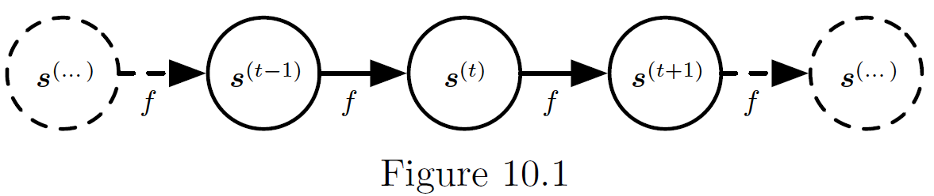
Intuition for Sequences
Dynamic systems have a “state” which gets updated over time
The current state depends on the previous state and a transition function

Slide 7
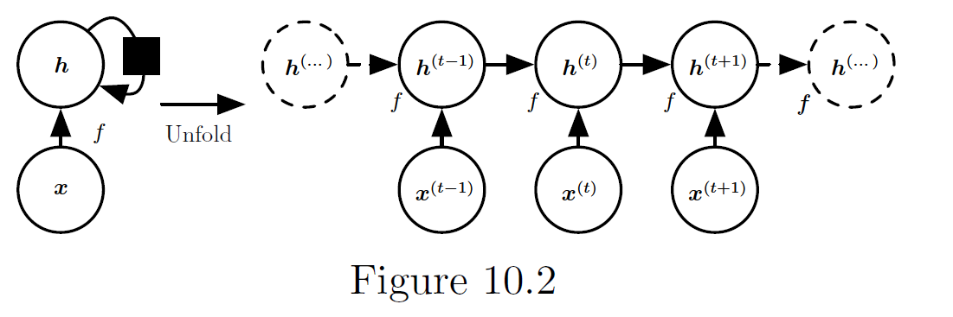
Recurrent State Graph – folded and unfolded
Our hidden state (h) can be updated via contribution from input (x) and a function with feedback: f (h^{(t-1)})
We can view the resulting network unfolded in time (steps)
This view informs how we could train it

Slide 8
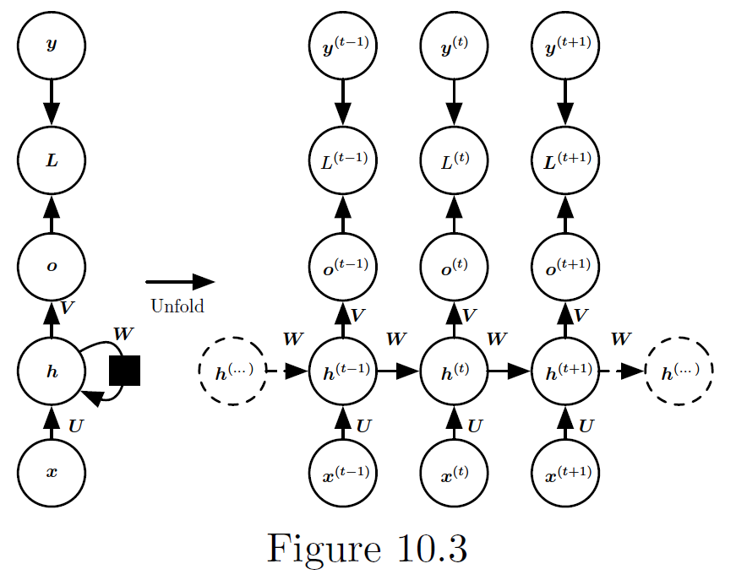
A simple RNN
Target
Loss
Output
Hidden State
Input
What information does the next state depend on?

Slide 9
A simple RNN
Target
Loss
Output
Hidden State
Input
What information does the next state depend on?

Slide 10
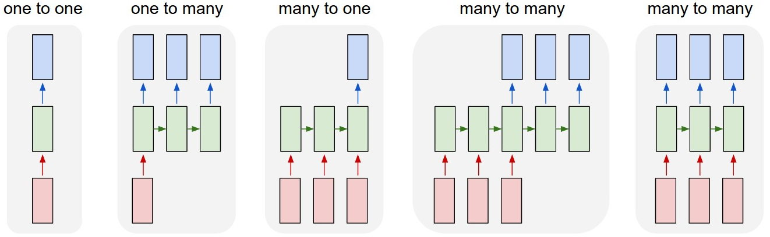
RNN Input/Output Types
Output
Input
http://karpathy.github.io/2015/05/21/rnn-effectiveness/
http://karpathy.github.io/assets/rnn/diags.jpeg
Key design decisions:
What is the input sequence length?
What is the output sequence length?

Slide 11
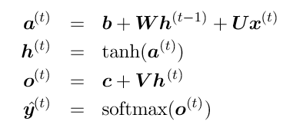
Forward Computation of Output
For each time step t , compute:
Target
Loss
Output
Hidden State
Input

Slide 12
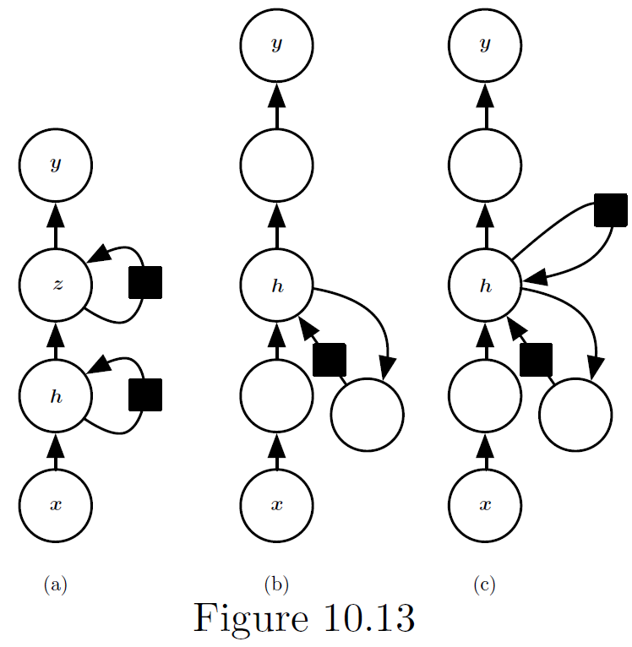
Deep RNNs
Much like other networks, RNNs can be deep too
Multiple layers of abstraction (a)
Recurrent connection through other layers (b)
Adding skip connections to reduce length of shortest path (c)

Slide 13

Training RNNs: Backprop Through Time (BPTT)
c1
b1
a1
c2
b2
a2
c3
b3
a3
c4
b4
a4
Number of timesteps for backprop is based on input sequence length
Gradient flows backwards from sequence step nodes
Gradients add at merges

Slide 14
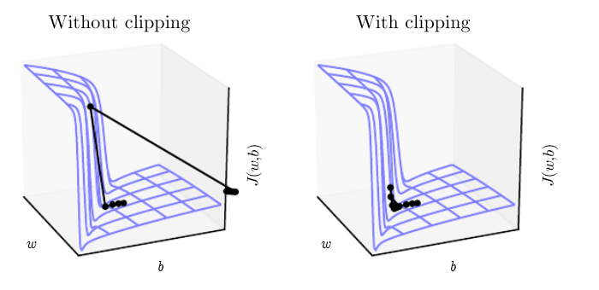
Issues: Exploding and vanishing gradients
Exploding gradients can be addressed with via gradient clipping
Vanishing Gradients cause RNN to struggle to learn things which were more than 10-20 steps back: Long Term Dependencies - need something different to handle this…

Slide 15
Advancements - A possible solution
What if we redesigned a separate memory upon which arbitrary information could be stored and held across all steps
Not just propagating the last step forward
Our memory would need
Ability to store/modify information… and maybe the ability to purposefully forget things
Ability to influence the (current) state using the stored information
Examples: LSTM & GRU

Slide 16
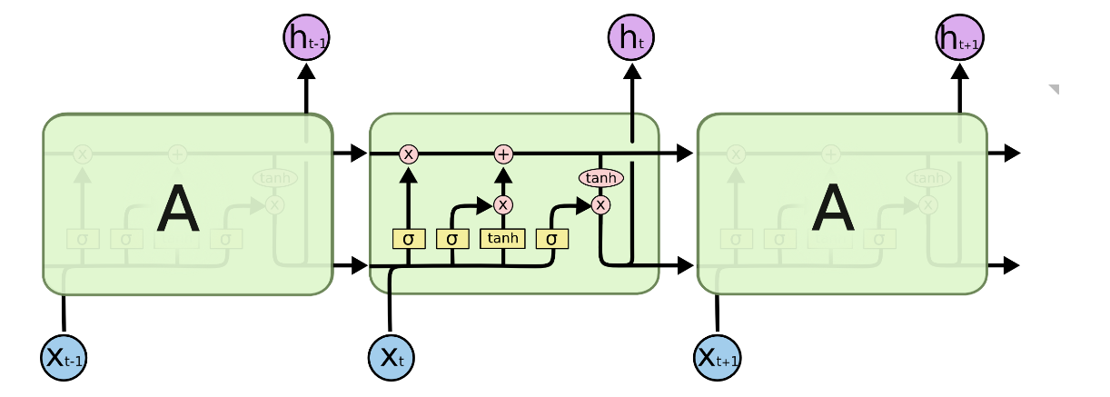
Long Short Term Memory (LSTM) Layer
h (sequence) goes to higher layer
Memory bus
State bus
X (sequence) comes from lower layer
From http://colah.github.io/posts/2015-08-Understanding-LSTMs/

Slide 17
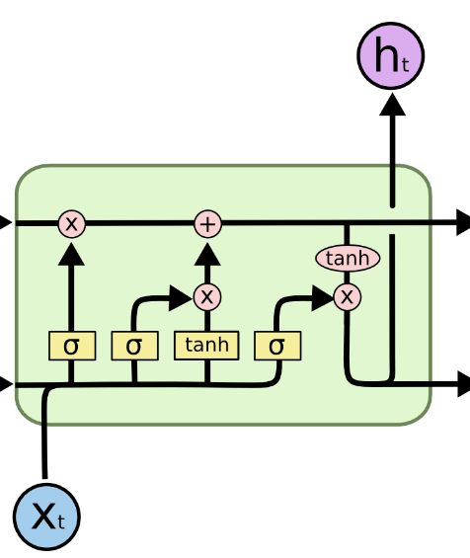
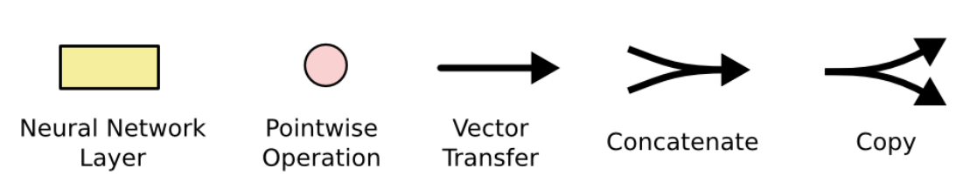
LSTM single step overview
Memory bus
State bus
From http://colah.github.io/posts/2015-08-Understanding-LSTMs/

Slide 18
LSTM single step overview
Modify Memory
Forget Gate
Memory bus
From http://colah.github.io/posts/2015-08-Understanding-LSTMs/

Slide 19
LSTM single step overview
Update State & output using memory
State bus
Concat input & state
From http://colah.github.io/posts/2015-08-Understanding-LSTMs/

Slide 20
LSTM single step overview
Modify Memory
Forget Gate
Memory bus
Update State & output using memory
State bus
Concat input & state
From http://colah.github.io/posts/2015-08-Understanding-LSTMs/

Slide 21
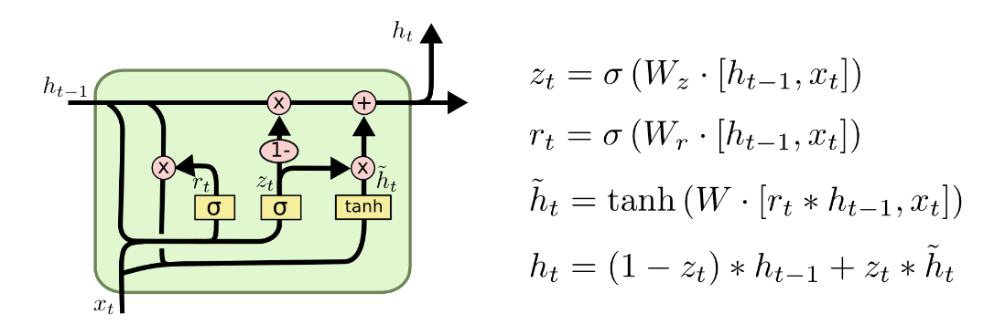
Gated Recurrent Unit (GRU)
Main changes from LSTM…
Combine state and memory on one bus
tie forgetting and remembering together
From http://colah.github.io/posts/2015-08-Understanding-LSTMs/

Slide 22
RNN Takeaway
LSTMs & GRUs are the textbook answer for long-sequence learning
… but other things are constantly being produced & tested
e.g. Temporal Convolutional Network https://medium.com/@raushan2807/temporal-convolutional-networks-bfea16e6d7d2 https://dida.do/blog/temporal-convolutional-networks-for-sequence-modeling

Slide 23
Learning Activity – Text generation with RNN (code demo)
Download zip from canvas & unzip into local directory
The file contains code, text data (Nietzsche), & previously trained models (1-20 epochs)
Open jupyter notebook “text-generation-with-lstm_from_model.ipynb” within the unzipped directory (but don’t run it yet)
Review the notebook without running
If you have a GPU and have tensorflow installed and want to run it, first Duplicate the notebook so you don’t wreck the original
Note: Don’t try to run the code without a GPU and all the packages installed (see notes in first markdown cell).
Even with a modern 30XX Nvidia GPU this will take several minutes to run.
Google colab may or may not work… I have not tested it
Look at the outputs from various different saved models which were trained on a range of epochs from 1-20.

Slide 24
General Q&A

Slide 25
Backup Slides

Slide 26
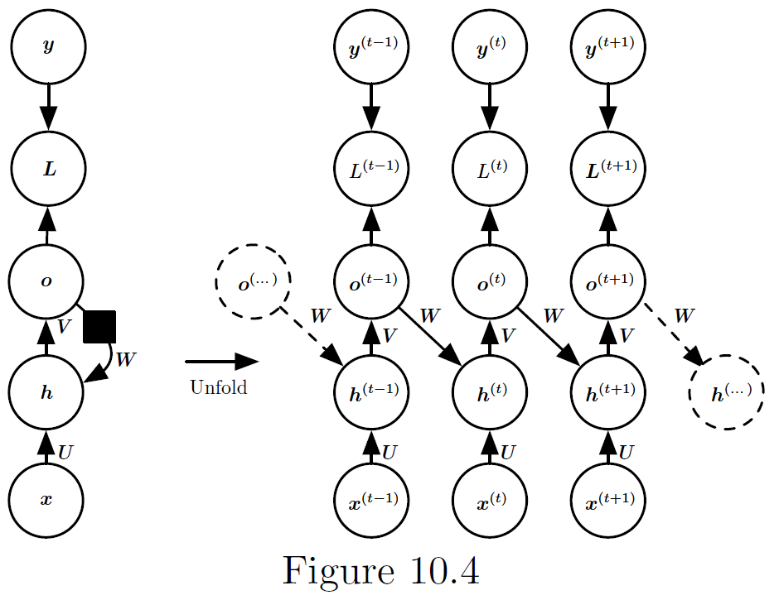
Output Recurrence
What info does the next state depend on?

Slide 27
Output Recurrence
What info does the next state depend on?

Slide 28

RNN training issues (1)
In output-recurrent networks, hidden state doesn’t affect next state directly
Training can be parallelized
Output must be rich enough to capture history ~ but we are propagating backwards… so how do we train this?

Slide 29
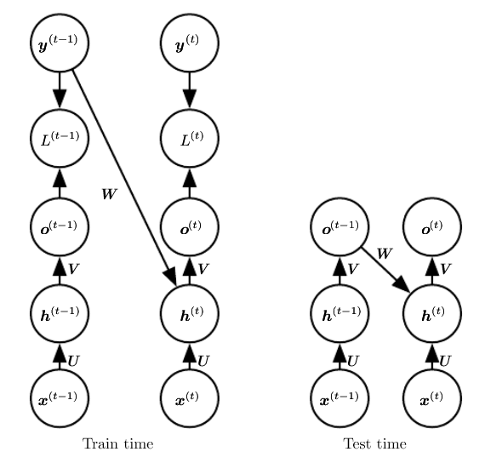
Solutions (1): Teacher Forcing
Instead of using the actual network produced output, Use the correct target to inform the next hidden state
Incorporates what the network should have known up to that point in the sequence

Slide 30
RNN Training Issues (2)
Classic backprop uses chain rule of calculus to multiplicatively compute gradients
Can create long distances to pass the gradient through when going back multiple time steps
Many multiplications cause vanishing or exploding gradients
Imagine 0.9^{n} versus 1.1^{n} as n grows large

